Slide 1
Qualified Teacher Learning and Skills (QTLS) Status
Date

Slide 2
Education and Training Foundation (ETF)
The ETF has a strong relationship with the Department for Education, which recognises the ETF’s unique expertise and funds many of the programmes they deliver.
We support teachers and leaders across the Further Education and Training sector to help them achieve their professional development goals for the benefit of learners and employers across England. In doing so, we help to transform the lives of individuals and communities across the country, unleashing potential and benefitting the economy.

Slide 3
The Society for Education and Training (SET)
SET is the only membership body dedicated to professionals working across further education, vocational teaching and training.
As part of the Education and Training Foundation (ETF), we campaign to raise the status of your profession, champion the quality of teaching and training across further education, vocational teaching and training and provide you with access to the best teaching and training tools, research and expert views there are.

Slide 4
Professional Status and Standards
Team
Andrew Dowell
Head of Professional Status and Standards
Berta Miguez – Lorenzo
Participant Experience Manager
Teresa Thomas
Professional Status Manager
Elaine Szpytma
Professional Status Co-ordinator
Tahira Khan
Disciplinary Investigation Officer
Lewis Dan
Professional Status Co-ordinator

Slide 5
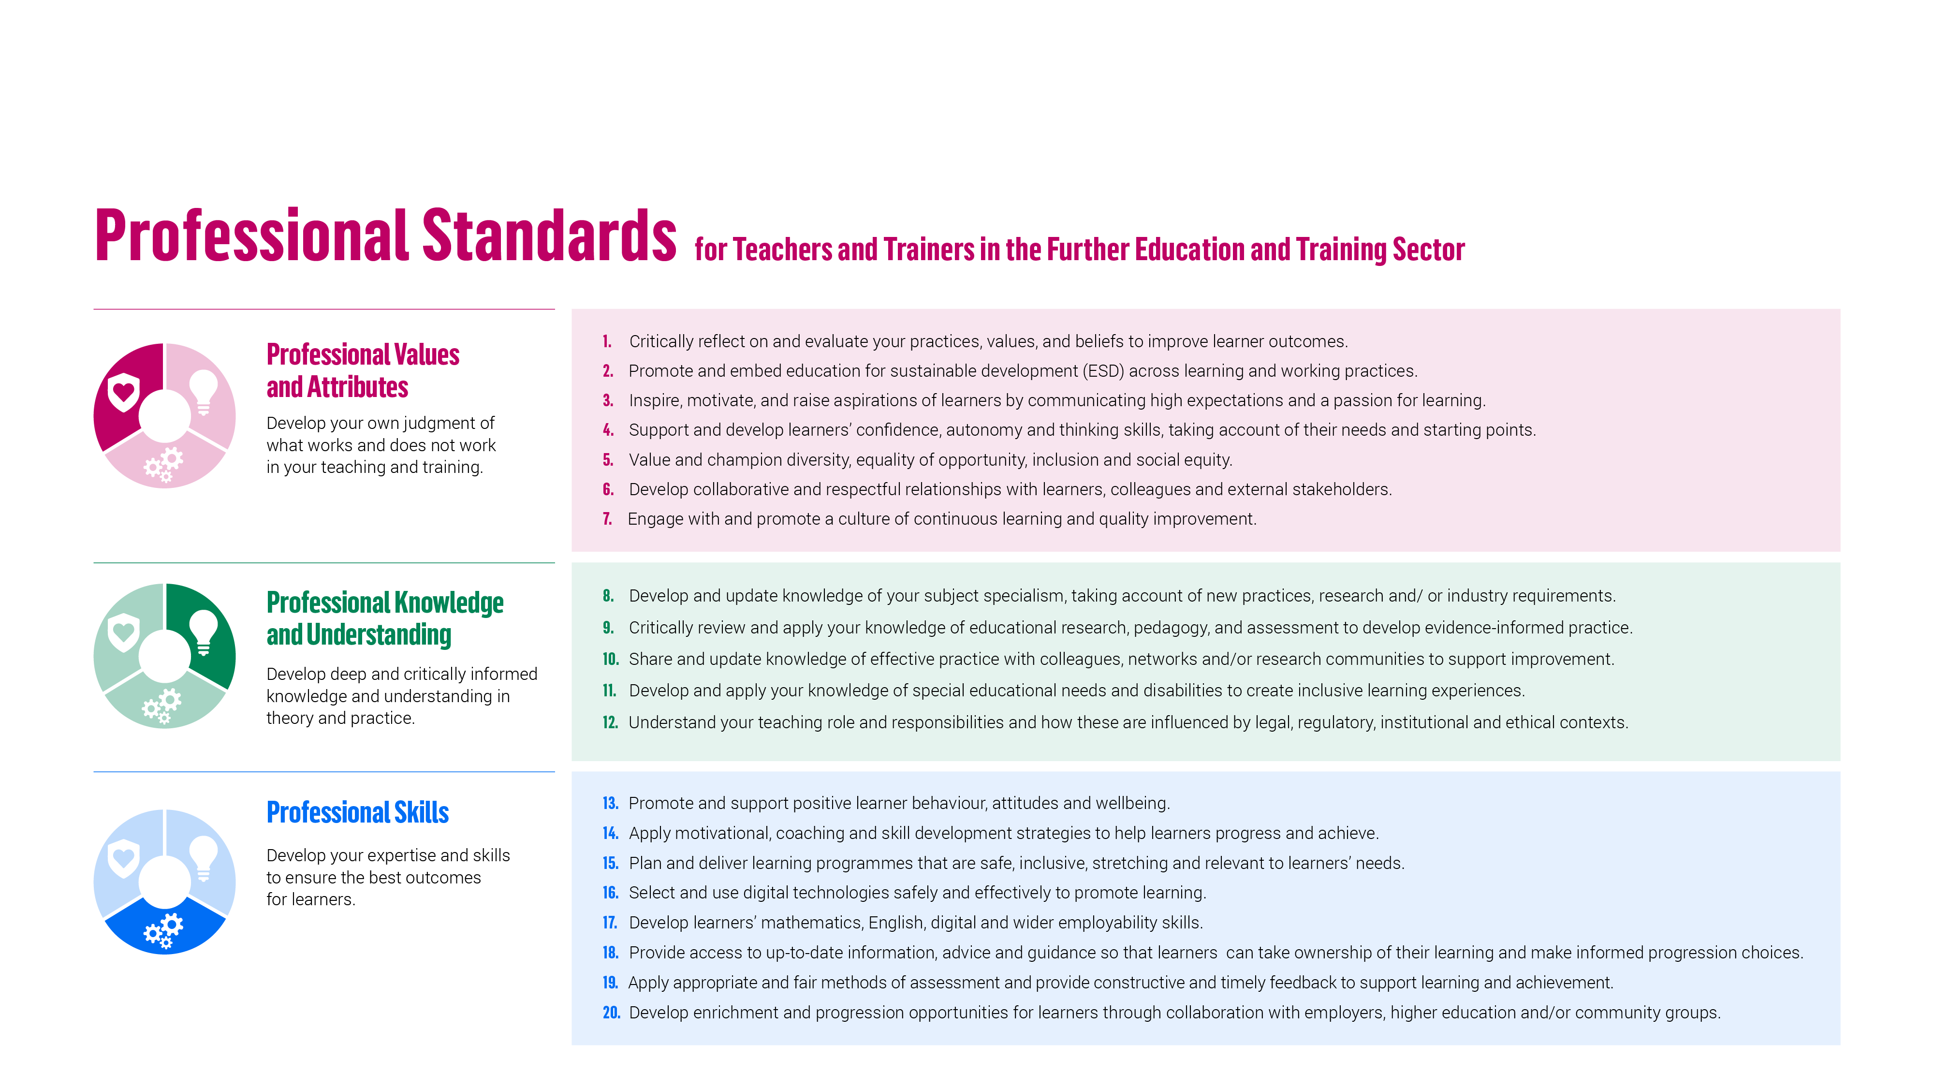
2022 Professional Standards

Slide 6
Teacher Career Stages Using the Professional Standards
Education & Training Foundation
Notes:
AD

Slide 7
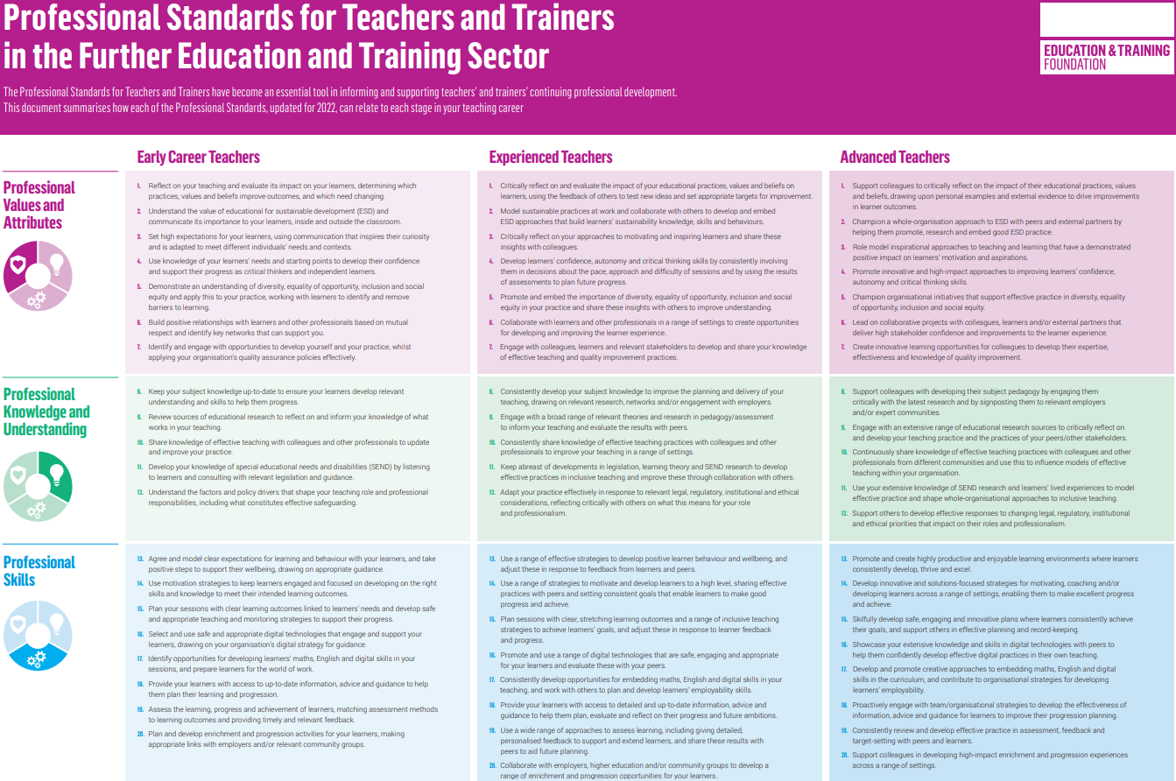
Teacher Career Stages
Notes:
AD

Slide 8
Professional Standards Self-Assessment 2022
Reflect on your teaching practice against the 20 professional standards
The standards provide a common framework for tracking development and this resource enables you to score yourself against each of the 20 standards and add comments. At the end, you can print a summary that includes charts that display your self-assessed skills.
SET administers both QTLS and ATS on behalf of the Education and Training Foundation

Slide 9
Professional Standards Self-Assessment
Reflect on your teaching practice against the 20 professional standards
The standards provide a common framework for tracking development and this resource enables you to score yourself against each of the 20 standards and add comments. At the end, you can print a summary that includes charts that display your self-assessed skills
https://portfolio.et-foundation.co.uk/selfassessment2022

Slide 10
Initial Teacher training
Professional Career Journey for teachers
Professional Development
Advanced Teacher
Further Education
Working towards
Diploma (DET)
5 years since ITE
PGCE/Cert Ed
QTLS
ATS
LST Apprenticeship
12 months
4 years since ITE
Chartered Teacher
Schools
3 years since ITE
Working towards
CTeach
PGCE/Cert Ed
QTS awarded
NQT/ECT
24 months
3 years since ITE

Slide 12
The journey to QTLS
QTLS
Professional Formation
Application
Registration
SET membership

Slide 13
QTLS Figures
26,000+
have achieved QTLS since 2008
1,100+
700+
started QTLS in Oct22
started QTLS in Jan23

Slide 14
Key Questions
01
02
03
04
05
06
07
What is professional formation and why apply? What are the stages, timescales and eligibility? What evidence should be collected?
How SET can support applicants? How are portfolios reviewed? What makes a good application? What are the steps for applying?

Slide 15
01
What is professional formation and why apply?

Slide 16
Qualified Teacher Learning and Skills (QTLS)
QTLS status is the badge of professionalism for teachers and trainers in the Further Education and Training sector
QTLS is a nationally recognised status that you can gain after achievement of your initial teacher education qualification by completing a professional formation process, where you demonstrate development of your skills and knowledge through your teaching practice.

Slide 17
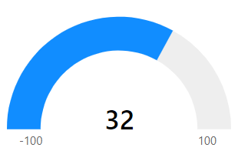
Impact – QTLS Oct-22 Cohort
What do members who have completed QTLS say?
98.6%
Impact on learner outcomes
98.6%
90%
Impact on own practice
Impact on the organisation
NPS
Notes:
QTLS Oct-22 participant experience report - 98.6% felt that the process has significant or some impact on their learners, 90% reported significant impact on their organisations, and 98.6% reported significant impact on their own practice.

Slide 18
Benefits
Recognition of your status as a professional teacher or trainer
Shows your commitment, skills and knowledge to employers
Valuable CPD
You can develop your digital skills and work collaboratively with colleagues
Use of MSET QTLS designation
A natural progression route towards ATS
SET administers both QTLS and ATS on behalf of the Education and Training Foundation

Slide 19
Teach in schools?
QTLS has legal parity with QTS
1 April 2012 the Department for Education (DfE) changed the law to add QTLS status to the list of qualifications and statuses equivalent to QTS. This change followed a recommendation from the 2011 Review of Vocational Education.
"Since 1 April 2014, further education teachers who have been awarded QTLS by the Society for Education and Training and are members, are recognised as qualified teachers in schools."

Slide 20
02
What are the stages, timescales and eligibility?

Slide 21
Timescale – One programme - 2 stages
Stage 1: Application | Registration period | Applications open | Application portfolios submitted for review | Review period | Notification of results
 | August | August | November | December | Early-January
Stage 2: Professional Formation | Portfolios issued | Portfolios submitted for review | Review period | Notification of results
January start | Mid-January | June | July | August

Slide 22
QTLS Eligibility
 | Active SET Membership
 | A mentor who can support you throughout the process
 | ITE qualification at Level 5 or above (e.g. Diploma in Education and Training or PGCE)
 | Maths and English qualifications at Level 2 or above
 | A subject qualification at Level 3 or above
 | A subject qualification at Level 3 or above for every subject you teach for 5 or more hours, during Professional Formation (you must upload at least one certificate at Level 3)
 | A minimum of 10 hours teaching practice per week with post-14 learners in a group setting (5 or more learners per group)
 | If you work in a SEND/SEMH setting, a broad Level 2 (or higher) qualification in SEND (Young people and Adults)
Important
You must have received all your certificates prior to applying for professional formation
Notes:
If you teach several subjects, all less that 5 hours per week, you need to upload at least one Level 3 subject qualification for one of the subjects you teach.

Slide 23
03
What evidence should be collected?

Slide 24
Key Activities - Application
The Application Portfolio has the following sections:
About you
Qualifications
Roles and responsibilities
Endorsement

Slide 25
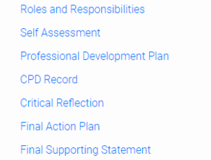
Key Activities – Professional Formation
The Professional Formation Portfolio has the following sections:
Self-assessment against the 2022 professional standards
Professional development plan
Continuing professional development record (CPD Record)
Critical reflection on impact with supporting evidence
Self-Assessment and Final Action Plan
Final supporting statement
5. Final action plan
1. Self-assessment
4. Critical reflection
2. Professional development plan
3. CPD record

Slide 26
04
How SET can support participants?

Slide 27
Support from SET – For participants
Before application
Customer Services centre and email address for registration and application
Professional standards self assessment tool
Webinars
During Professional Formation
Customer Services centre for queries
Technical and professional status mailboxes
Help button in the portfolio
Webinars and Q&A Sessions
Regular newsletters
Facebook community
After application submission
Detailed feedback on application submission

Slide 28
Support from SET – For supporters
During Professional Formation
The supporter’s details are available to SET only after you have entered them in your portfolio.
Customer Services centre for queries
Technical and professional status mailboxes
Webinars
Regular newsletters
In addition, you supporter has access to your Professional Formation portfolio via their supporter’s dashboard.

Slide 29
05
How are Professional Formation portfolios reviewed?

Slide 30
The review and moderation process
All reviewers have been through professional formation themselves
It is an online process working directly in the portfolio
Each reviewer is allocated up to 24 portfolios
Each portfolio takes roughly an hour to review
Each moderator has 5 reviewers and there are 2 lead moderators
Tight timescales in working towards final evaluation meeting so that each review is completed within one month
Rigorous but flexible review of portfolios

Slide 31
06
What makes a good Professional Formation Portfolio?

Slide 32
What makes a good Professional Formation Portfolio?
Strong self-assessment, marking the beginning of the journey
A thread running through the whole process, with everything relating back to the self-assessment and PDP
Selective with respect to focus of CPD – not trying to do too much
Clear and precise narrative with quality evidence added at each stage
Strong critical reflection of the impact of the journey on their practice, learners and organisation
Evidence that learners clearly benefited
Reference to relevant educational theory and research
Active supporter throughout the process
Strong supporting statement, confirming progression and development

Slide 33
07
What are the steps for applying?

Slide 34
SET…
GET

Slide 35
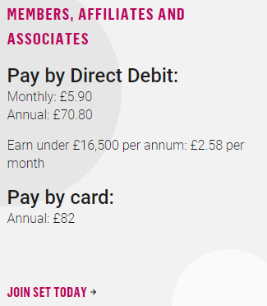
SET Membership
01
FREE Membership for the duration of teacher education studies
Notes:
https://set.et-foundation.co.uk/membership

Slide 36
SET Membership benefits
01
Notes:
https://set.et-foundation.co.uk/membership

Slide 37
Check your suitability to apply online
Read the eligibility criteria and check whether you in a suitable position to apply for professional formation, via the SET website:
Your Career tab
QTLS
Am I eligible? section
Use the suitability to apply tool:
https://set.et-foundation.co.uk/utility-pages/complete-the-qtls-suitability-to-apply-tool
02
Notes:
https://set.et-foundation.co.uk/your-career/qtls/qtls-eligibility-guidance

Slide 38
Register for QTLS
Once the Registration window opens, register to apply for Professional Formation, leading to QTLS.
Please visit the QTLS website for updates on the next registration window.
Pay £50 to apply (non-refundable)
Pay £475 in full by credit/debit card or by one direct debit payment
OR Pay £100 as a deposit by credit/debit card + 3 x monthly payments of £125.
03
£50
Application
£475
Programme

Slide 39
Receive a certificate of achievement upon completion
Can use the 'MSET QTLS' designation
Can start ATS, once it has been 4 years since your ITE
Upon completion of QTLS

Slide 40
Qualified Teacher Learning and Skills (QTLS)
An early career status gained after achievement of an initial teacher education qualification.
2
 | Summary
Why | Nationally recognised badge of professionalism providing opportunities to work in the school sector (parity with QTS)
Who | ITE qualification (L5+) holders who have already received their certificate, working with a group of post 14 students (minimum 5) in an FE and Training setting for 10+ hours per week
How | 6 month period of professional formation, where evidence is added to an ePortfolio
When | Apply between 01 August and 30 November. Successful applicants will be issued their Professional Formation portfolio in mid-January. Visit the QTLS website for updates on future application windows.
£50
Registration
£475
Programme

Slide 41
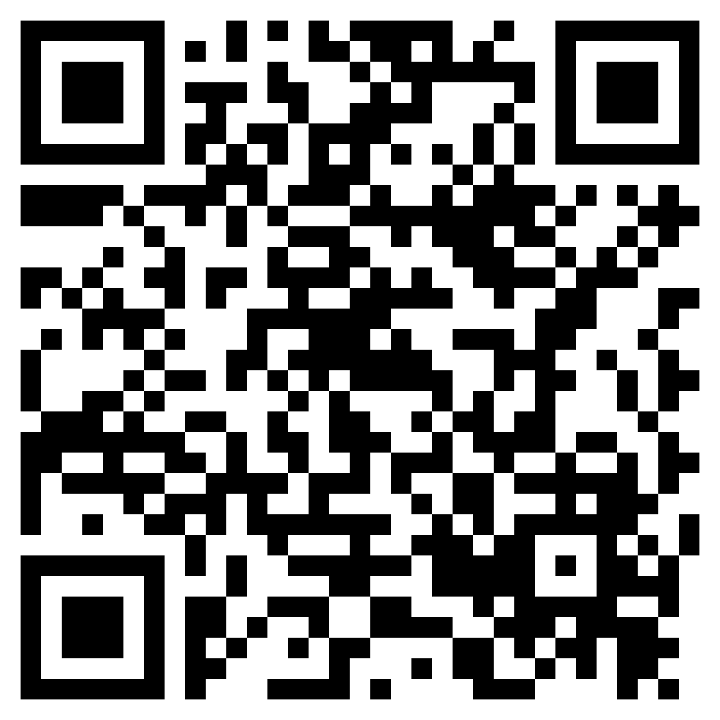
If you haven’t already – join SET now!
Your journey starts here…
Notes:
https://set.et-foundation.co.uk/membership/join-as-a-student-for-free

Slide 42
Any questions?

Slide 43
QTLS: membership@etfoundation.co.uk
Contact us
Call our helpline on 0800 093 9111
Opening times:
Monday to Friday 9.30am - 5pm

