Slide 1
Qualified Teacher Learning and Skills (QTLS) Status
<insert name>
<insert job title>
<insert date>

Slide 2
Education and Training Foundation (ETF)
The ETF has a strong relationship with the Department for Education, which recognises the ETF’s unique expertise and funds many of the programmes they deliver.
We support teachers and leaders across the Further Education and Training sector to help them achieve their professional development goals for the benefit of learners and employers across England. In doing so, we help to transform the lives of individuals and communities across the country, unleashing potential and benefitting the economy.

Slide 3
The Society for Education and Training (SET)
SET is the only membership body dedicated to professionals working across further education, vocational teaching and training.
As part of the Education and Training Foundation (ETF), we campaign to raise the status of your profession, champion the quality of teaching and training across further education, vocational teaching and training and provide you with access to the best teaching and training tools, research and expert views there are.

Slide 4
Professional Status and Standards
Team
Andrew Dowell
Head of Professional Status and Standards
Berta Miguez – Lorenzo
Participant Experience Manager
Teresa Thomas
Professional Status Manager
Elaine Szpytma
Professional Status Co-ordinator
Paul Tully
Professionalism Manager
Tahira Khan
Disciplinary Investigation Officer
Lewis Dan
Professional Status Co-ordinator

Slide 6
Initial Teacher training
Professional Career Journey for teachers
Professional Development
Advanced Teacher
Further Education
Working towards
Diploma (DET)
5 years since ITE
PGCE/Cert Ed
QTLS
ATS
LST Apprenticeship
12 months
4 years since ITE
Chartered Teacher
Schools
3 years since ITE
Working towards
CTeach
PGCE/Cert Ed
QTS awarded
NQT/ECT
24 months
3 years since ITE

Slide 7
QTLS Figures
26,000+
have achieved QTLS since 2008
1,200+
700+
started QTLS in Oct21
started QTLS in Jan22

Slide 8
Key Questions
01
02
03
04
05
06
07
What is professional formation and why apply? What are the stages, timescales and eligibility? What evidence should be collected?
How SET can support applicants? How are portfolios reviewed? What makes a good application? What are the steps for applying?

Slide 9
01
What is professional formation and why apply?

Slide 10
Qualified Teacher Learning and Skills (QTLS)
QTLS status is the badge of professionalism for teachers and trainers in the Further Education and Training sector
QTLS is a nationally recognised status that you can gain after achievement of your initial teacher education qualification by completing a professional formation process, where you demonstrate development of your skills and knowledge through your teaching practice.

Slide 11
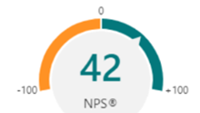
QTLS Impact – 2020/21
98%
QTLS had a positive impact upon...
Impact on learner outcomes
98%
91%
Impact on the organisation
Impact on own practice
NPS

Slide 12
Benefits
Parity with QTS
Shows your commitment, skills and knowledge to employers
Valuable CPD
You can develop your digital skills and work collaboratively with colleagues
Recognition of your status as a professional teacher or trainer
Use of MSET QTLS designation
A progression route to ATS
SET administers both QTLS and ATS on behalf of the Education and Training Foundation

Slide 13
Teach in schools?
QTLS has legal parity with QTS
1 April 2012 the Department for Education (DfE) changed the law to add QTLS status to the list of qualifications and statuses equivalent to QTS. This change followed a recommendation from the 2011 Review of Vocational Education.
"Since 1 April 2014, further education teachers who have been awarded QTLS by the Society for Education and Training and are members, are recognised as qualified teachers in schools."

Slide 14
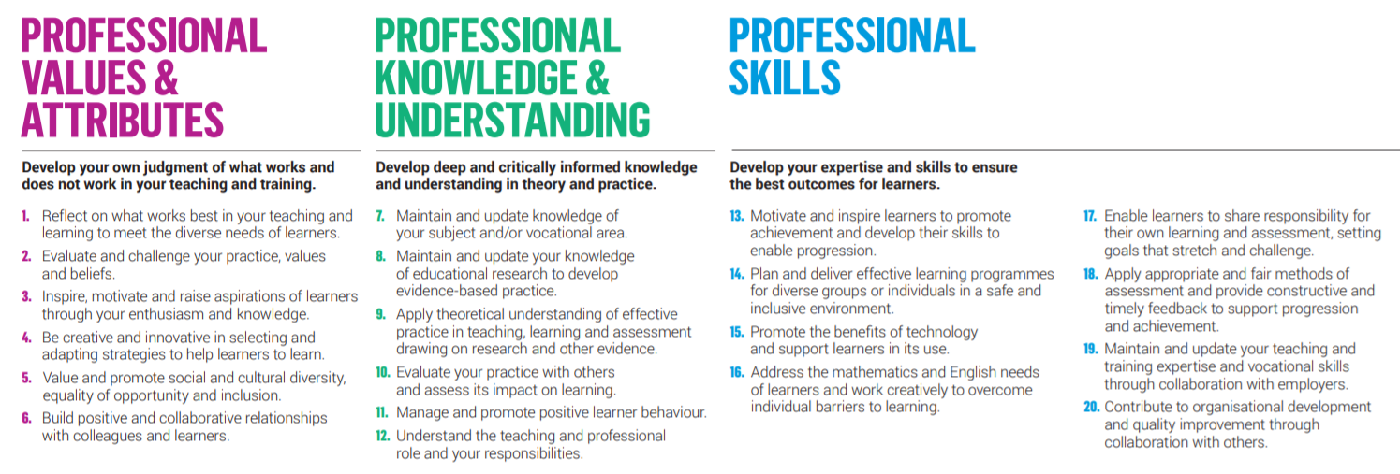
Professional Standards

Slide 15
Professional Standards Self-Assessment
https://set.et-foundation.co.uk/digital-assets/self-assessment/
Reflect on your teaching practice against the 20 professional standards
The standards provide a common framework for tracking development and this resource enables you to score yourself against each of the 20 standards and add comments. At the end, you can print a summary that includes charts that display your self-assessed skills.
SET administers both QTLS and ATS on behalf of the Education and Training Foundation

Slide 16
The Professional Formation Cycle
1. Self-assessment
2. Professional development plan
3. CPD record
4. Critical reflection
5. Final action plan

Slide 17
02
What are the stages, timescales and eligibility?

Slide 18
QTLS Eligibility
 | ITE qualification at Level 5 or above (e.g. Diploma in Education and Training or PGCE)
 | Maths and English qualifications at Level 2 or above
 | A mentor who can support you throughout the process
 | Level 3 maths/English if you teach maths/English

Slide 19
Timescale
 | Registration period | Portfolios issued | Portfolios submitted for review | Review period | Notification of results
October Start | September | October | March | April | May
January Start | December | January | June | July | August

Slide 20
03
What evidence should be collected?

Slide 21
Key Activities
The Portfolio has the following sections:
About you: roles and responsibilities
Self-assessment against the 2014 professional standards
Professional development plan
Continuing professional development record
Critical reflection on impact
Final action plan
Sharing your workbook

Slide 22
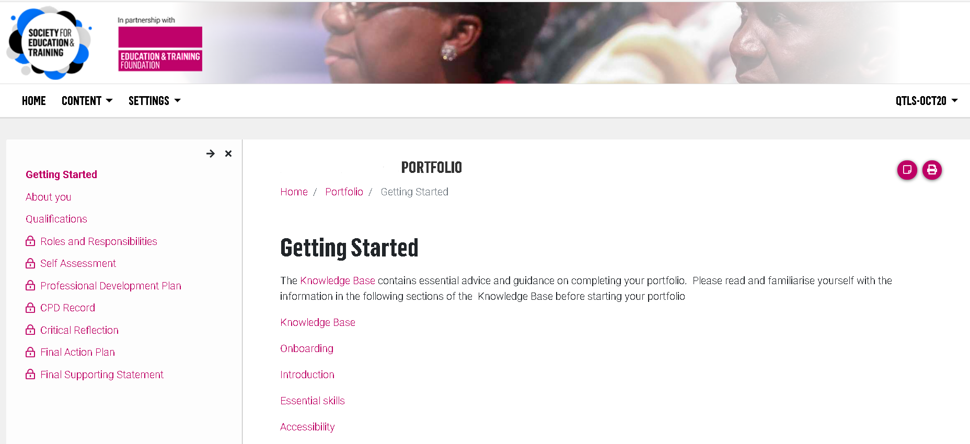
QTLS Portfolio

Slide 23
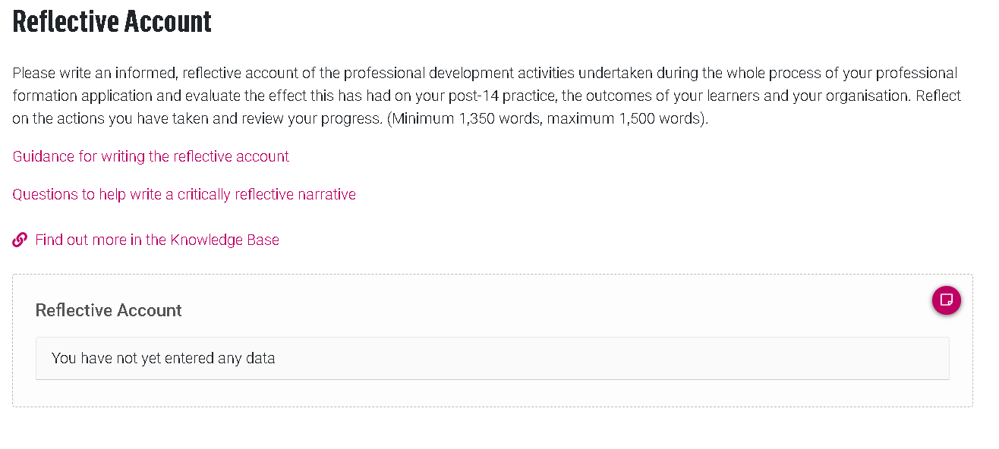
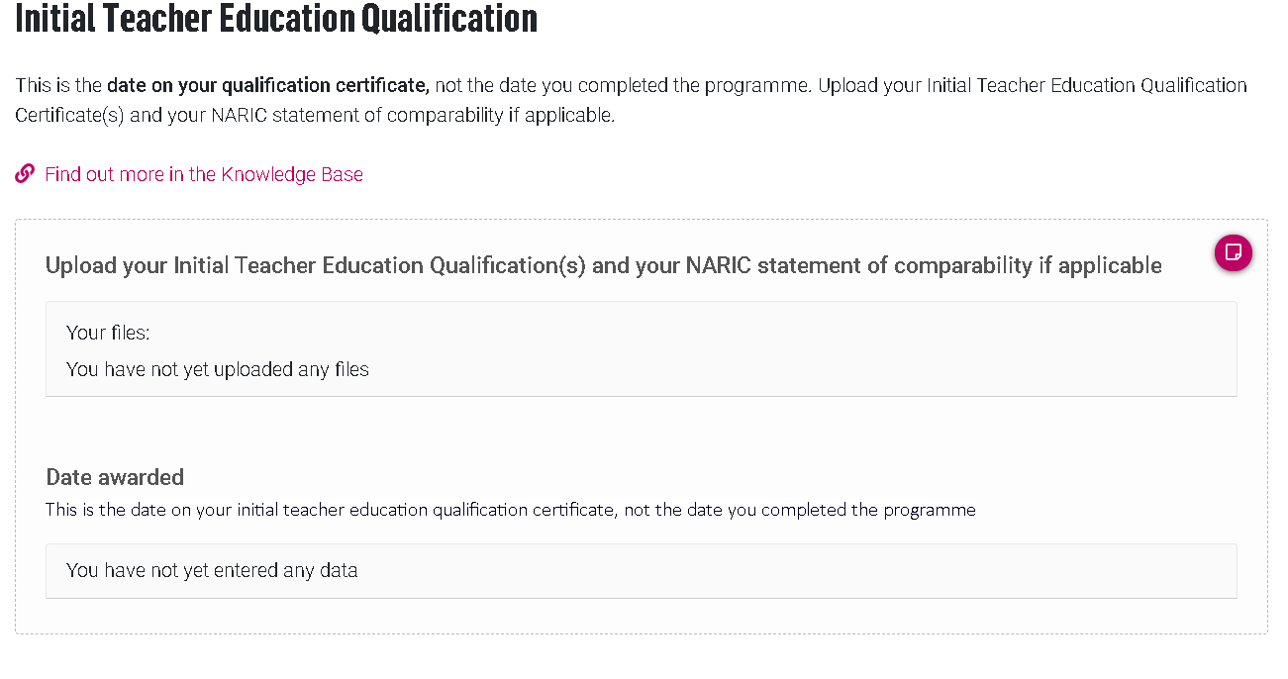
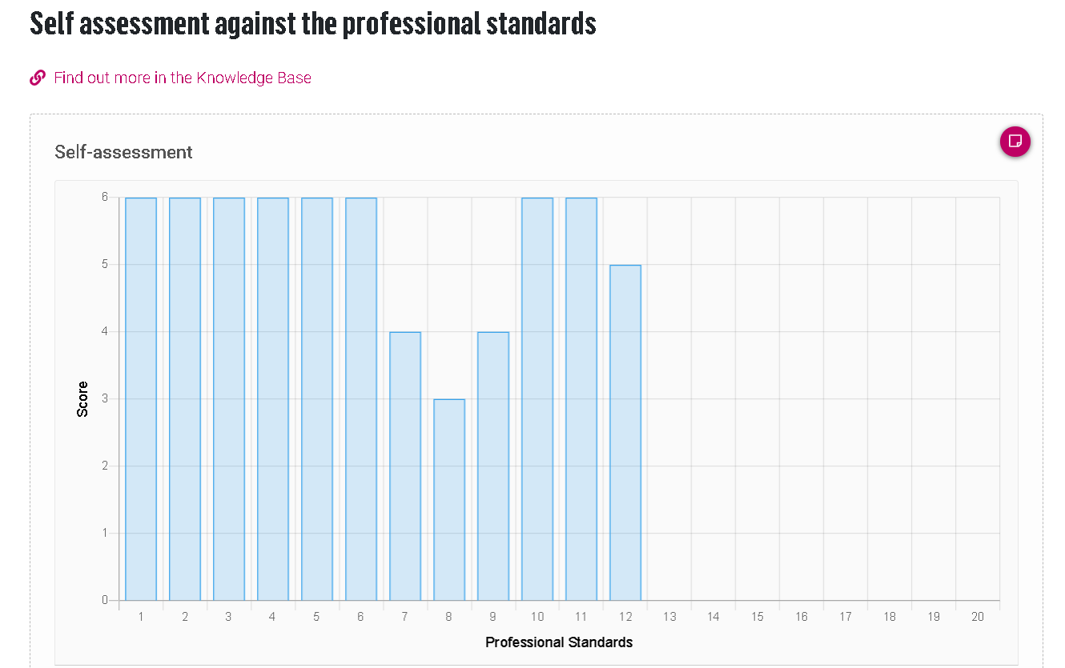
QTLS Portfolio

Slide 24
04
How SET can support applicants?

Slide 25
Support from SET
Before
Call centre and email address for eligibility and registering
Professional standards self assessment tool
Webinars
During
Call centre for queries
Technical and professional status mailboxes
Local Networking groups
Facebook community
After
Detailed feedback on portfolio submission

Slide 26
05
How are portfolios reviewed?

Slide 27
The review and moderation process
All reviewers have been through professional formation themselves
It is an online process working directly in the portfolio
Each reviewer is allocated up to 20 portfolios
Each portfolio takes roughly an hour to review
Each moderator has 5 reviewers and there are 2 lead moderators
Tight timescales in working towards final evaluation meeting so that each review is completed within one month
Rigorous but flexible review of portfolios

Slide 28
06
What makes a good application?

Slide 29
What makes a good application?
 | Strong self assessment, marking the beginning of the journey
 | A thread running through the whole process, with everything relating back to the self assessment and PDP
 | Selective with respect to focus of CPD – not trying to do too much
 | Clear and precise narrative with quality evidence added at each stage
 | Strong critical reflection of the impact of the journey on their practice, learners and organisation
 | Evidence that learners clearly benefited
 | Reference to relevant educational theory and research
 | Active supporter throughout the process
 | Strong supporting statement, confirming progression and development

Slide 30
07
What are the steps for applying?

Slide 31
SET…
GET

Slide 32
SET Membership
Annual membership starts from just £5.90 per month (£70.80 total) by direct debit for a standard membership
Opportunity to undertake QTLS and ATS
Intuition magazine
Access to webinars, networking events
On-line research library
Mentoring service
https://set.et-foundation.co.uk/membership/free-student-membership-offer/
01
FREE Membership for ITE Students

Slide 33
Express your interest
You can express your interest in undertaking QTLS via the SET website
https://set.et-foundation.co.uk/professionalism/set-programmes/express-your-interest-in-qtls/
Completing this form will also allow you to check your eligibility.
02

Slide 34
Register for QTLS
Once the Registration window opens register for QTLS.
Pay £500 in full by credit/debit card or by one direct debit payment
OR Pay £125 as a deposit by credit/debit card + 3 x monthly payments of £125
03
£500

Slide 35
Upon completion of QTLS
Receive a certificate of achievement upon completion
Can use the 'MSET QTLS' designation
Can start ATS, once it has been 4 years since your ITE

Slide 36
Qualified Teacher Learning and Skills (QTLS)
An early career status gained after achievement of an initial teacher education qualification.
Why | Nationally recognised badge of professionalism providing opportunities to work in the school sector (legal parity with QTS)
Who | ITE qualification (Lv 5+) holders with a minimum of 6 months post ITE award, who work with post 14 students for 4+ hours per week
How | 6 month period of professional formation, where evidence is added to an ePortfolio
When | After registration, portfolios issued in either October or January
£500

Slide 37
Any questions?

Slide 38
membership@etfoundation.co.uk
Contact us

